Slide 1


Information Hiding using Deep Generative Models
Rohit Gandikota
IIST batch 2015
Scientist -SC, NRSC
Under Guidance of Dr. Deepak Mishra
(CVVR Lab, IIST)
Indian Institute of Space science and Technology

Slide 2
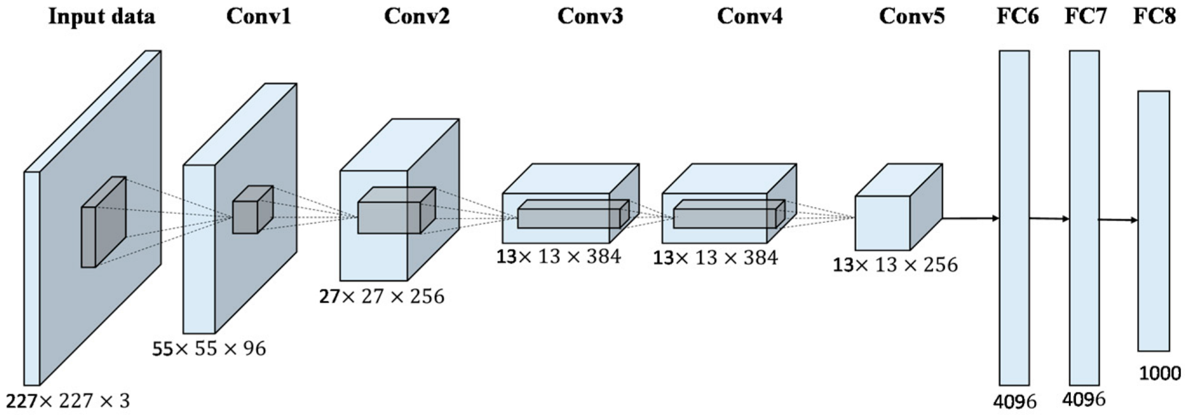
Convolutional Neural Network

Slide 3
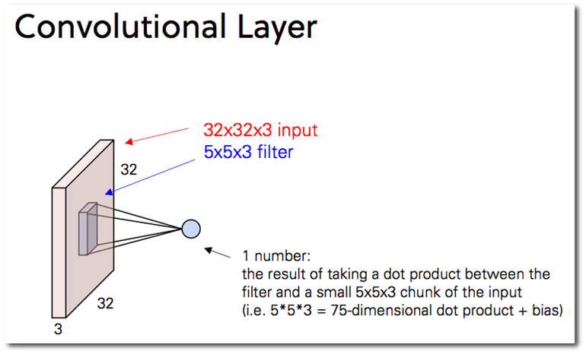

Slide 4
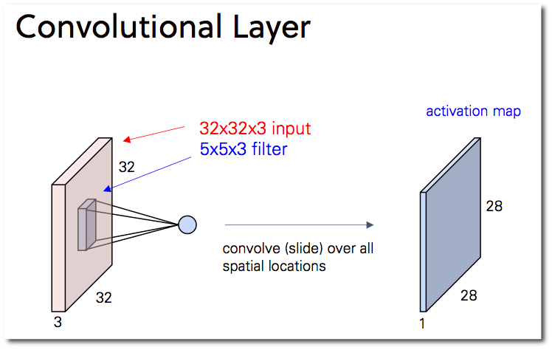

Slide 5
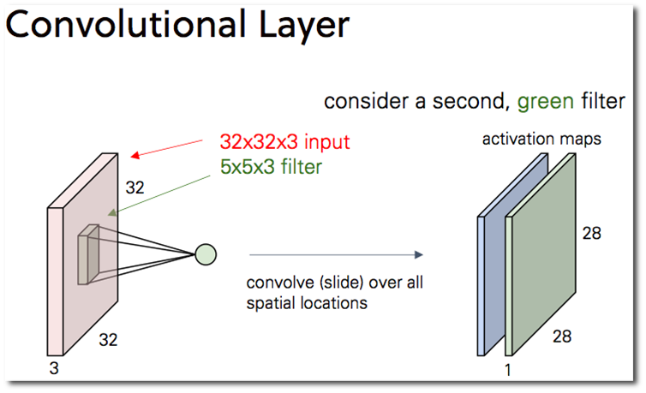

Slide 6
Classification Network (A classical variant of CNN)

Slide 7
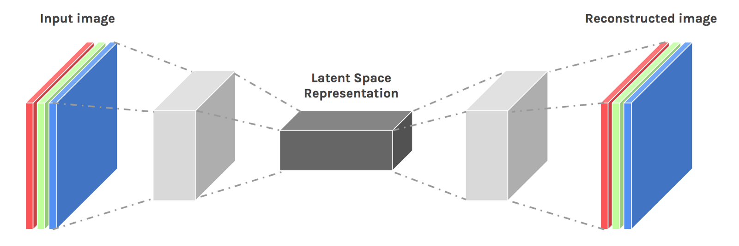
Autoencoder (another variant of CNN)

Slide 8
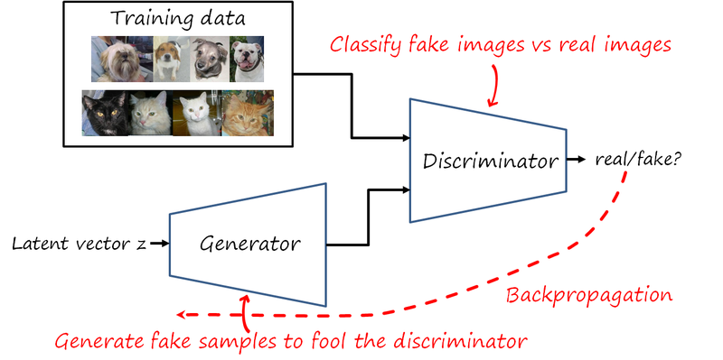
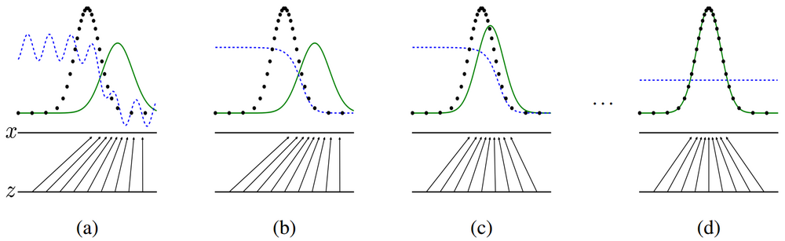
GANs : Generative Adversarial Networks
Learning the data distribution in an adversarial way.
No direct learning for generator.
Gradients from discriminator to generator.
Dying gradients (Mode collapse)
(Goodfellow et al, 2013 NIPS)

Slide 9
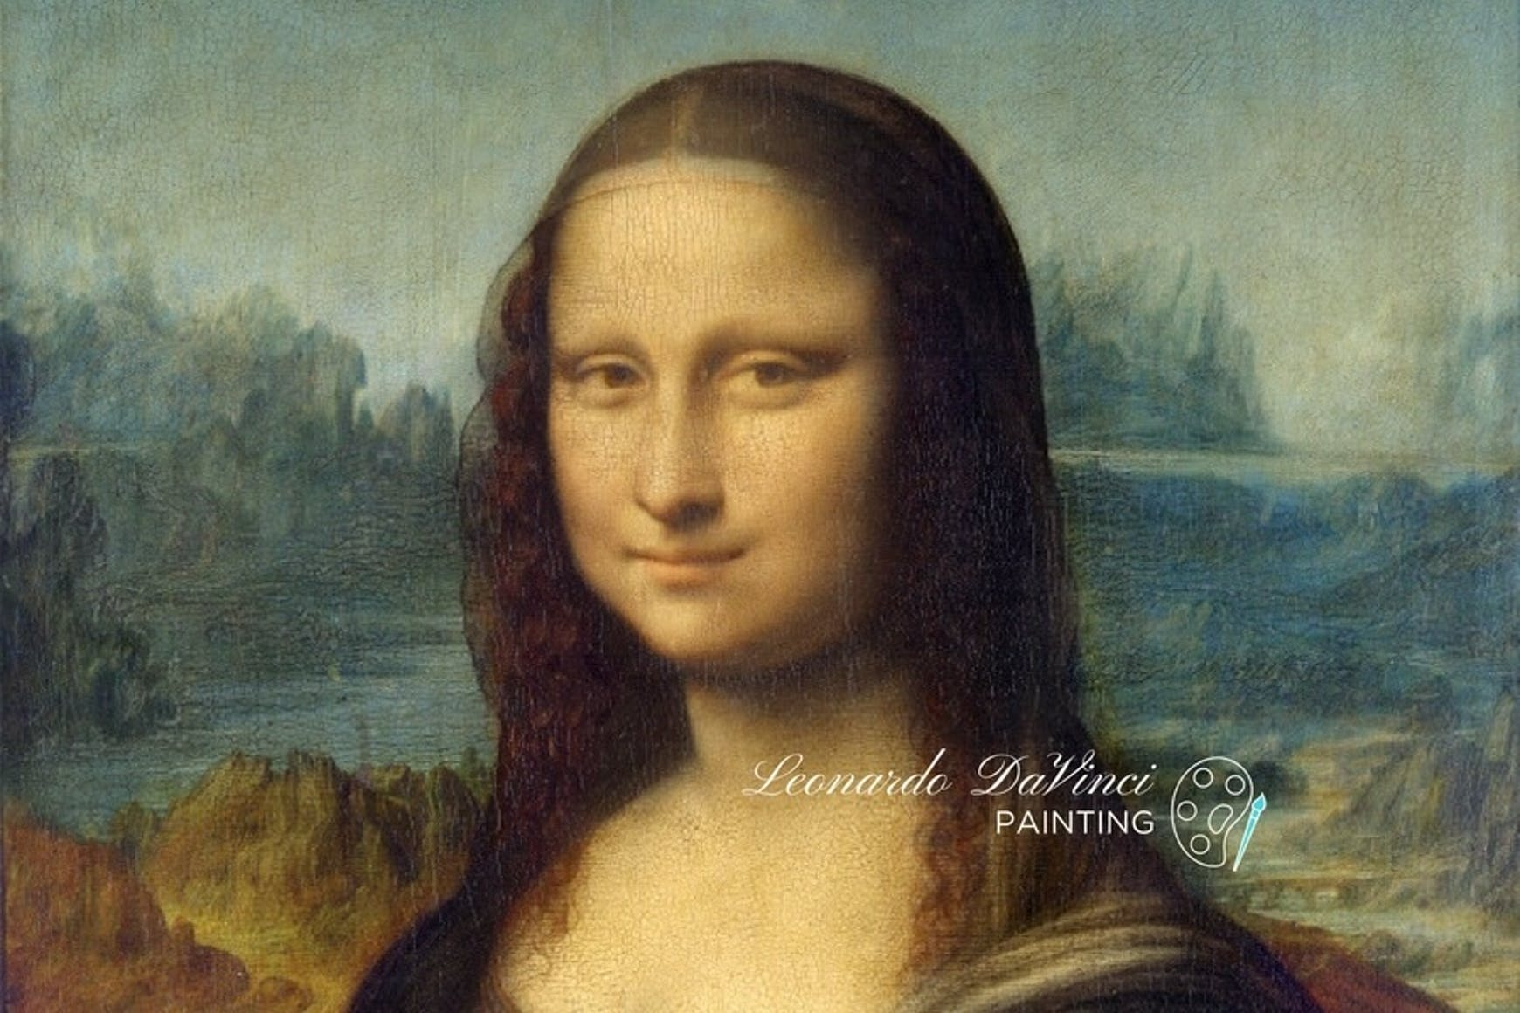
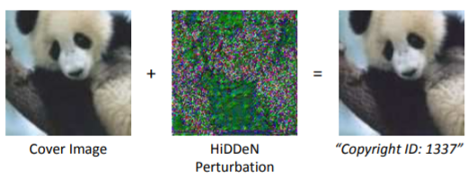
Data Hiding
Steganography
Watermarking
The goal is secret communication between a sender and a receiver, while an adversary person cannot tell if the image contains any message.
The goal is to encode information robustly. Even though an adversary distorts the image, the receiver can extract the message.
(Fei Fei Li et al, 2018 ECCV)

Slide 10
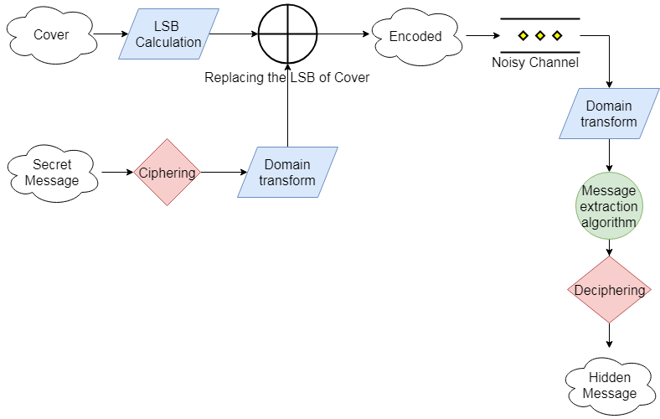
Traditional Data hiding

Slide 11
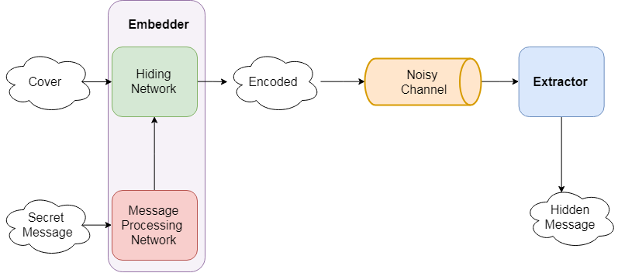
Data hiding using Deep Learning

Slide 12
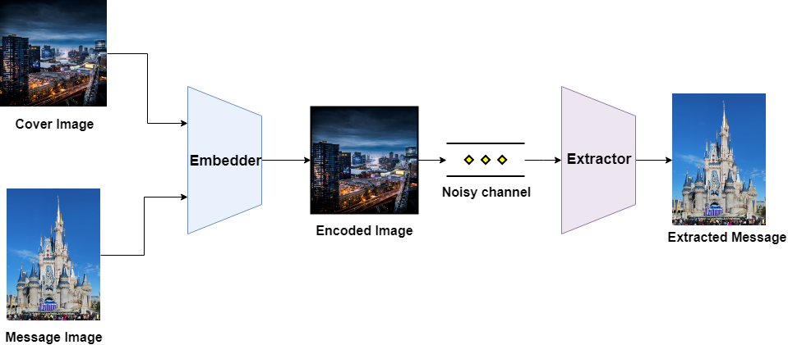
Hiding Image in Image

Slide 13

Watermarking
Watermarking is typically used to identify ownership or copyright the data in the content creation industry.
Usually requirement for a single watermark by a user. Therefore no need for a generic embedding.
Since used majorly by content creation industry, invisibility of the watermark is as important as robustness towards attacks to remove the watermark.

Slide 14
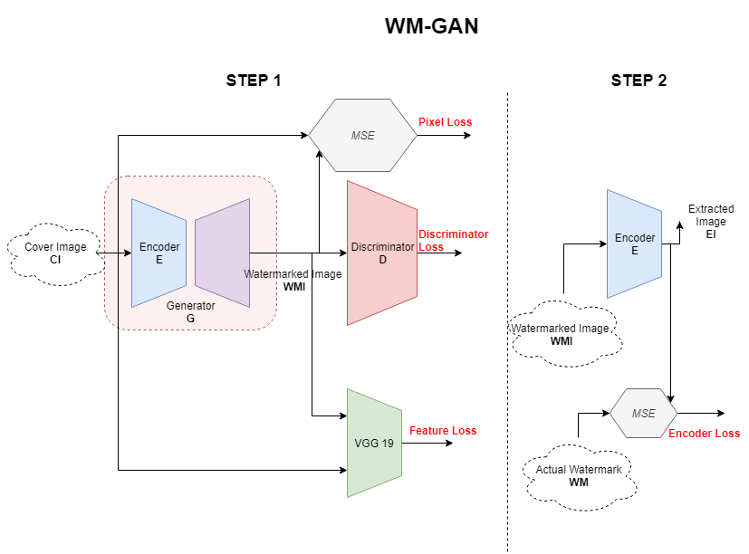
Proposed Method
Rohit G, Deepak Mishra, WM-GAN: Watermarking using Adversarial Network, Under peer review in pattern recognition letters
Implicit 2 stage training of WM-GAN
Train the generator G, to output image similar to input.
Train the encoder of generator E, to output the watermark given the output of G.
A cover image passed through G is “embedded” since, the encoder of the G has information about the watermark.
The output of E is the embedded message as the input of stage 2 is output of stage 1 that is “encoded”.
Notes:
Create a gif showing training process

Slide 15
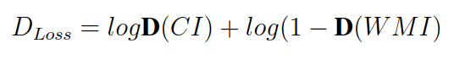
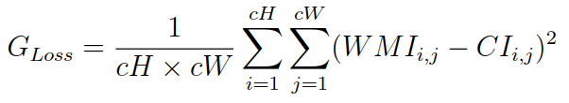
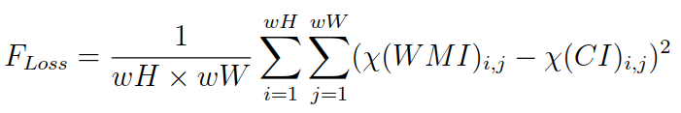
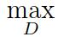
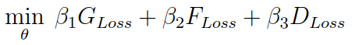
Training of WM-GAN: Stage 1
First stage is to train the generator G, to output an image WMI similar to the input cover image CI. This embedding was done using adversarial loss, reconstruction pixel loss and feature loss.
)

Slide 16
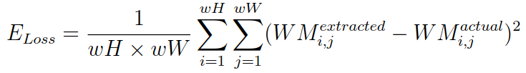
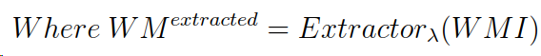
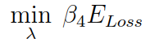
Training of WM-GAN: Stage 2
Second stage is to extract the watermark WM with the encoder E of the generator G from the watermarked image WMI.

Slide 17
Contributions to the watermarking society
To our knowledge, WM-GAN is the first end-to-end trainable model of Generative Adversarial Network solely dedicated for watermarking purpose.
Proposing an extractor as a sub-model of the embedder and adding the adversarial loss in the extractor’s training.
Had reduced the required number of networks, trainable parameters, training time and improved efficiency over the existing state-of-the-art methods.

Slide 18
Steganography
Steganography is secret communication between a sender and a receiver, while an adversary person cannot tell if the data contains any message.
Usually requirement for embedding multiple messages by a user. Therefore a need for generic embedding. (To embed any message into any cover)
A possibility for an attacker to try and extract or destroy the message. Therefore, robustness is also a minor requirement.

Slide 19
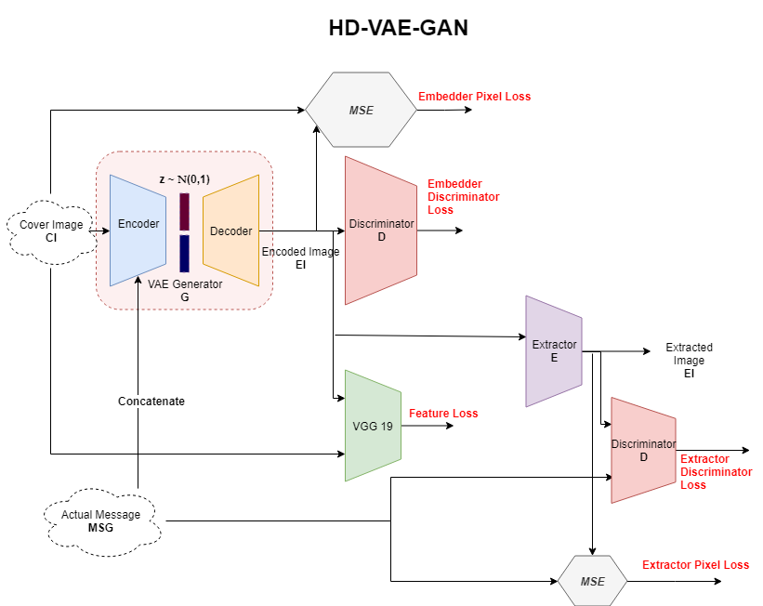
Proposed Method
G Rohit, D Mishra, HD-VAE-GAN: Hiding Data using Variational Autoencoder Generative Adversarial Network, submission to IEEE-SPL
Implicit 2 stage training of HD-VAE-GAN
Train the VAE generator G, to output image similar to cover image given message and cover as inputs.
Train the extractor E, to output the message given the output of G.
The “encoding” is done by concatenation process in the encoder of the VAE.

Slide 20
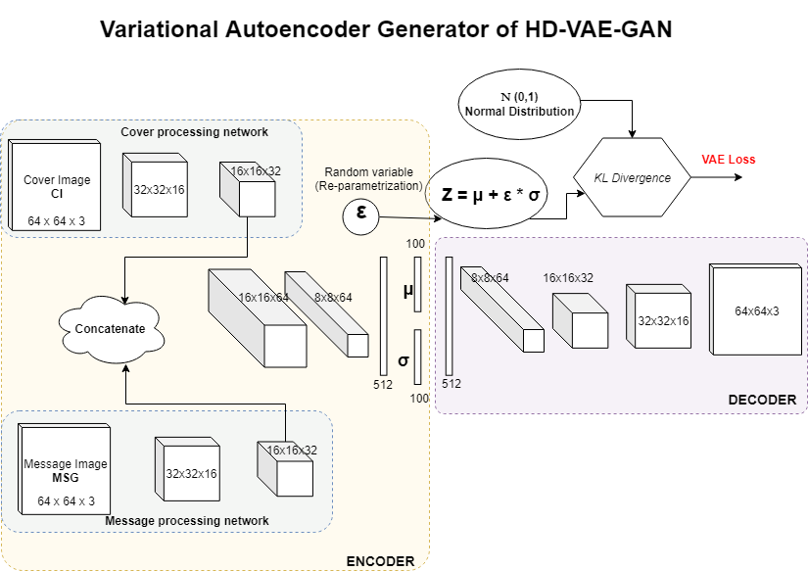
Training of HD-VAE-GAN: Stage 1
First stage is to train the generator G, to output an image EI similar to the cover image CI with message MSG and CI as inputs. This embedding was done using variational loss, adversarial loss, reconstruction pixel loss and feature loss.

Slide 21
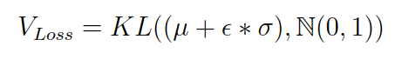
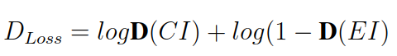
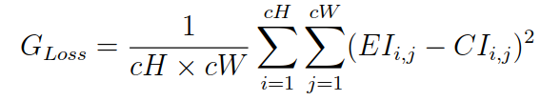
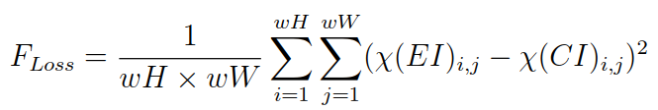
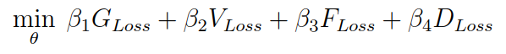
Training of HD-VAE-GAN: Stage 1
First stage is to train the generator G, to output an image EI similar to the cover image CI with message MSG and CI as inputs. This embedding was done using variational loss, adversarial loss, reconstruction pixel loss and feature loss.
)

Slide 22
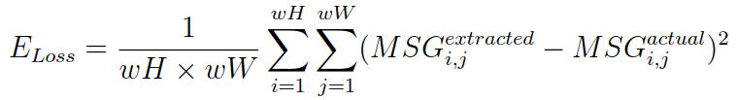
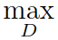
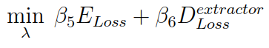
Training of HD-VAE-GAN: Stage 2
Second stage is to extract the message image MSG with the extractor E of from the encoded image EI.

Slide 23
Contributions to the steganography society
To our knowledge, HD-VAE-GAN is the first end-to-end trainable model of Variational Autoencoder Generative Adversarial Network for hiding images in images.
Proposing variational inference for the embedder and adding the adversarial loss in the extractor’s training.
Improved the robustness for steganography compared to the state-of-the-art methods. Making our method more convincing to opt.

Slide 24
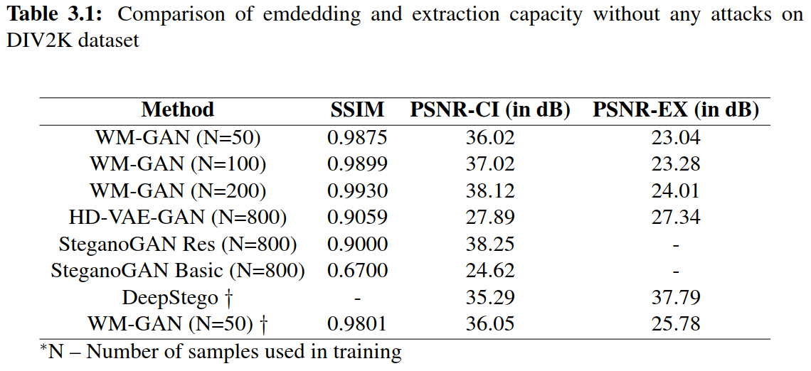
Experiment
We have used the DIV2K dataset to train and evaluate our model. The dataset consists of 900 images (800 train, 100 test) to evaluate our models.
HD-VAE-GAN has poor embedding but efficiency due to the variational inference, making the embedded images very close in distribution.

Slide 25
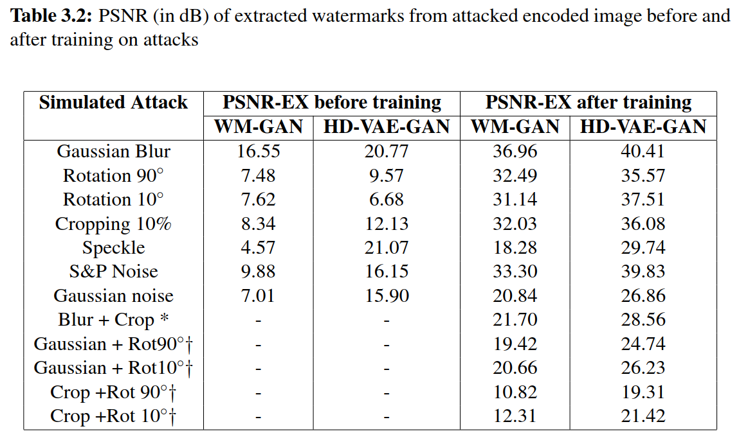
Experiment
The variational inference was a draw-back for the embedding process, however, this close distribution helped in a robust extraction.

Slide 26
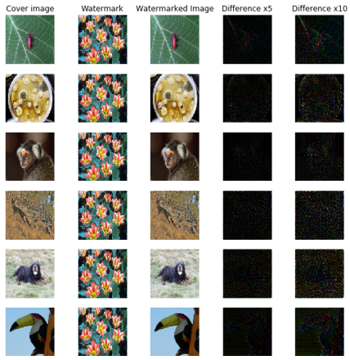
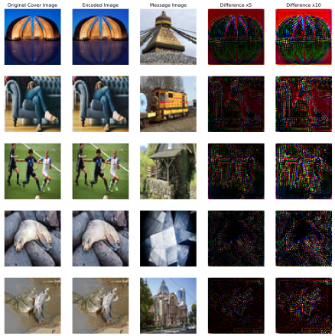
Analysis
Where is the encoding happening ?
Notes:
WM-GAN is robust to pixel level distortions and HD-VAE-GAN can not be deciphered even if attacker gets access to the original cover image

Slide 27
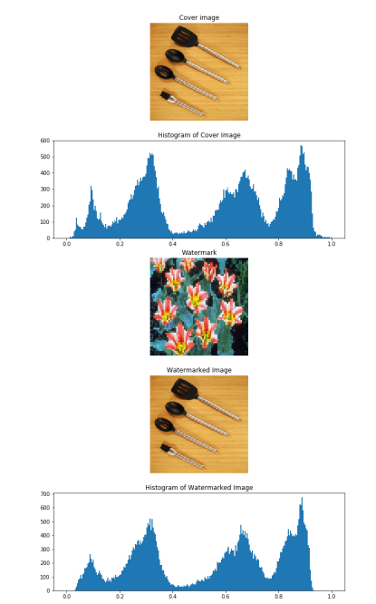
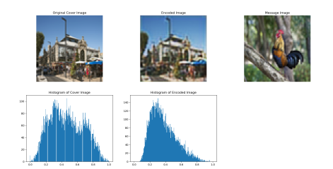
Analysis
Histogram analysis

Slide 28
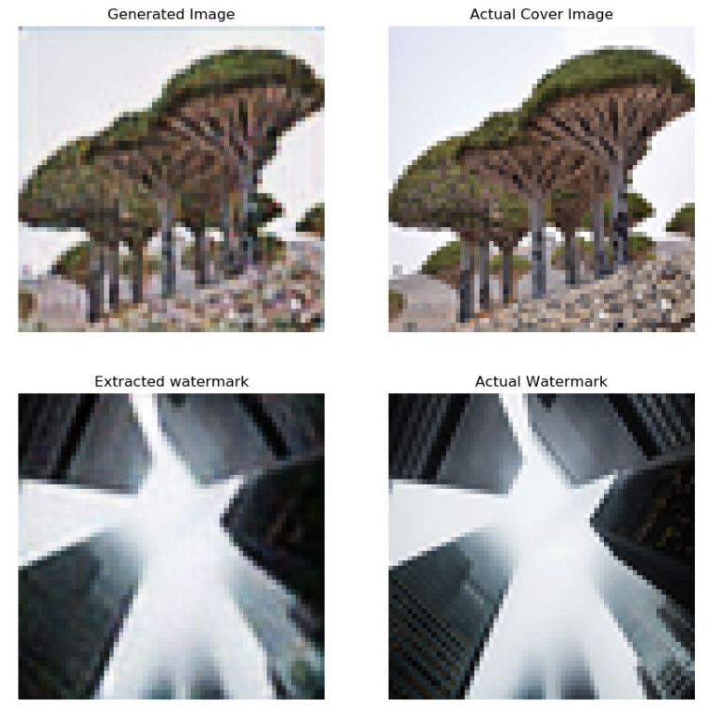
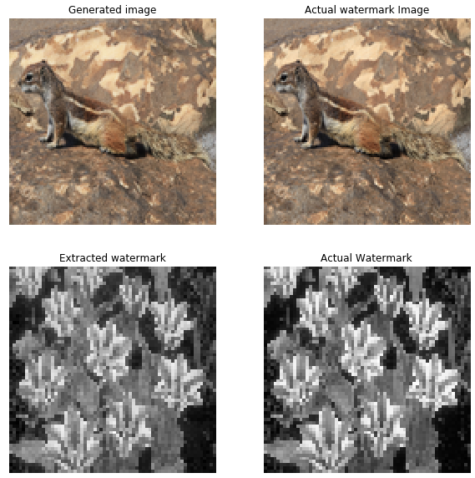
Visual samples

Slide 29
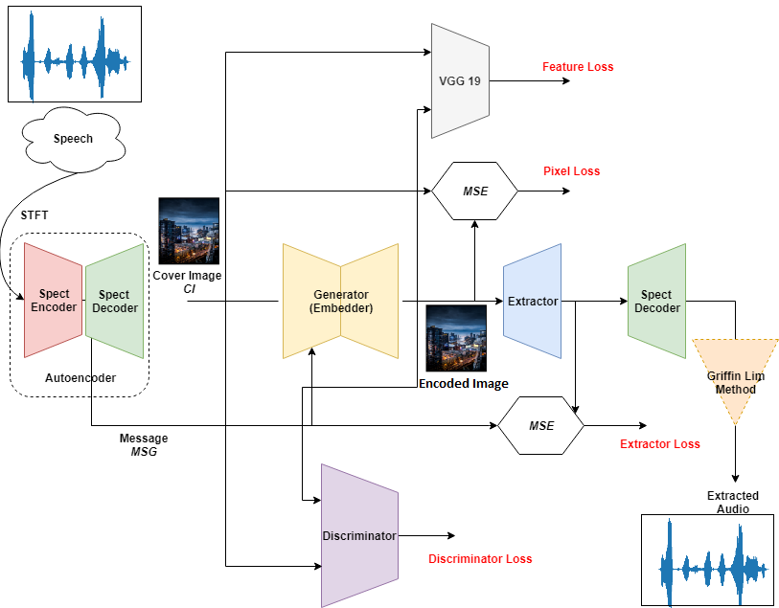
Hiding Audio in Image

Slide 30
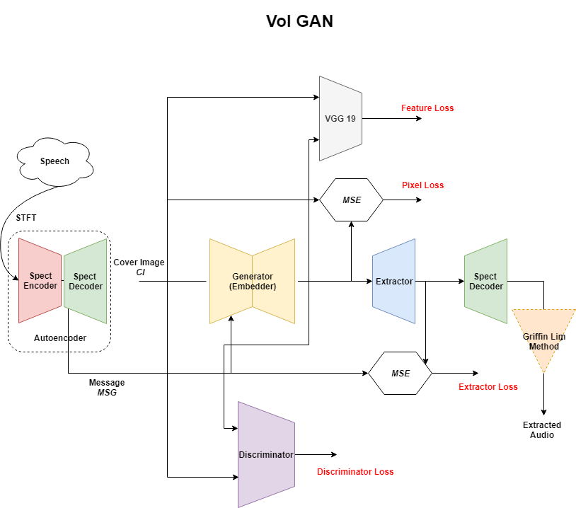
Proposed Method
G Rohit, D Mishra, VoI-GAN: Hiding Audio in Images, submission to Human Intelligent Systems Integration, springer
G Rohit, D Mishra, Hiding Audio in Images: A Deep Learning Approach , under review 8th International Conference of PReMI
3 stage implicit training of VoI-GAN
Train the autoencoder AE, to output image similar to input image.
Trin the embedder Emb, to output an image similar to cover given cover and latent spectrogram as input.
Train the extractor Ex, to output the latent spectrogram given the output of Emb.
The “encoding” is done by concatenation process in the encoder of the Emb.

Slide 31
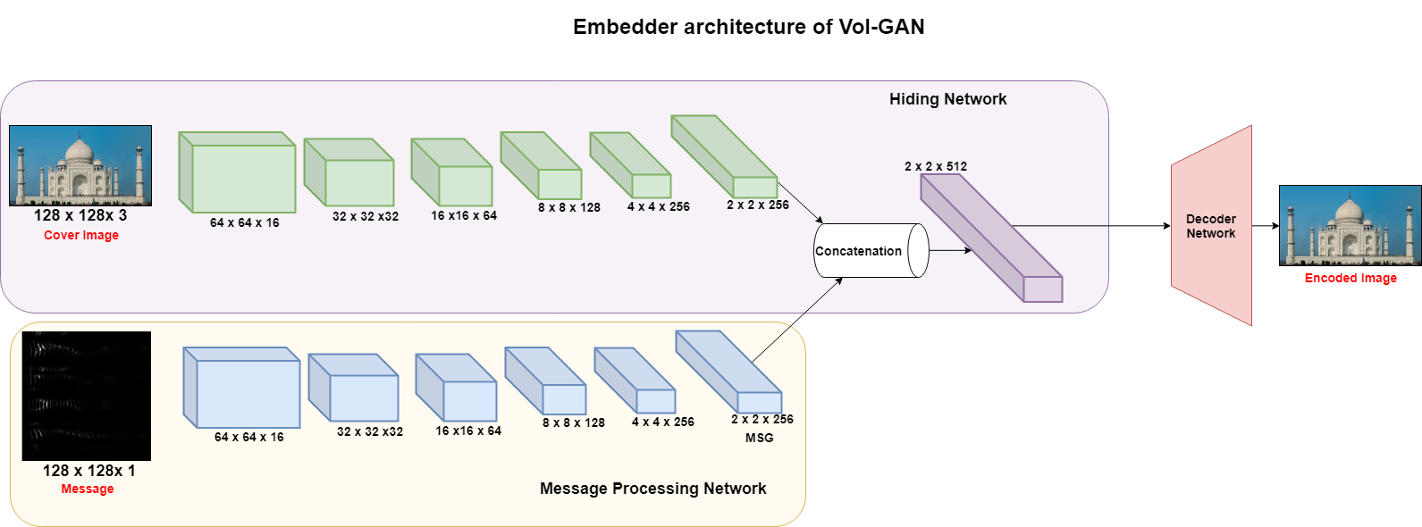
Training of HD-VAE-GAN: Stage 2
Second stage is to train the embedder Emb, to output an image EI that is similar to the cover image CI with message MSG and CI as inputs. This embedding was done using adversarial loss, reconstruction pixel loss and feature loss.

Slide 32
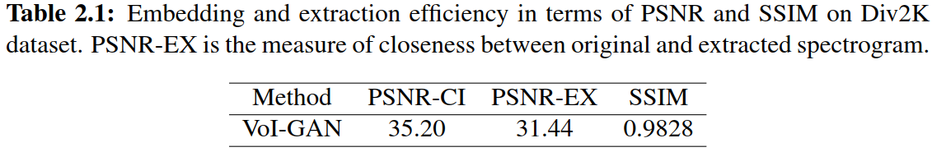
Experiment
We have used the DIV2K dataset to train and evaluate our model. The dataset consists of 900 images (800 train, 100 test) to evaluate our models and 800 audio files of 2 seconds length those are sampled at 8 kHz from a publicly available SignaLogic dataset.

Slide 33
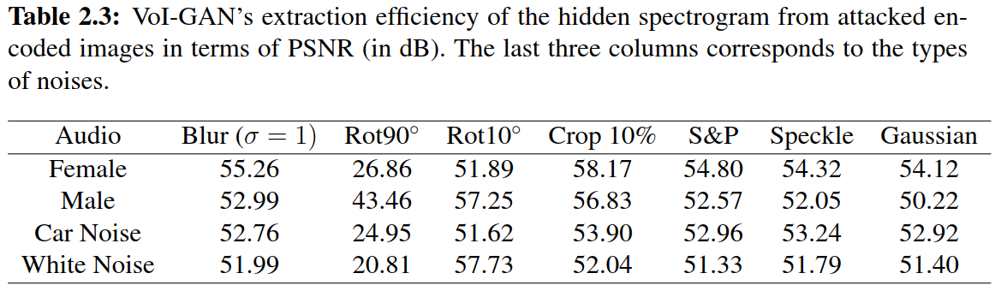
Experiment
Inherent robustness of the model towards multiple attacks due to the base learning and deep architecture.

Slide 34
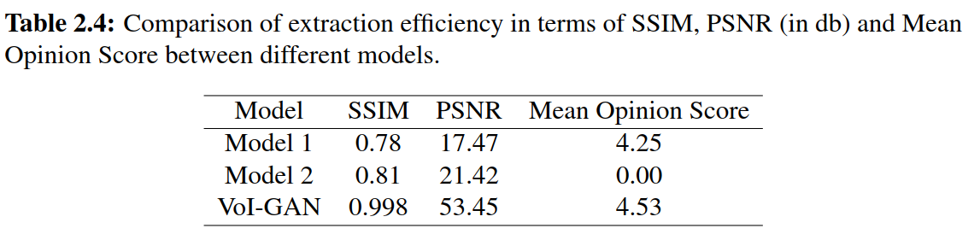
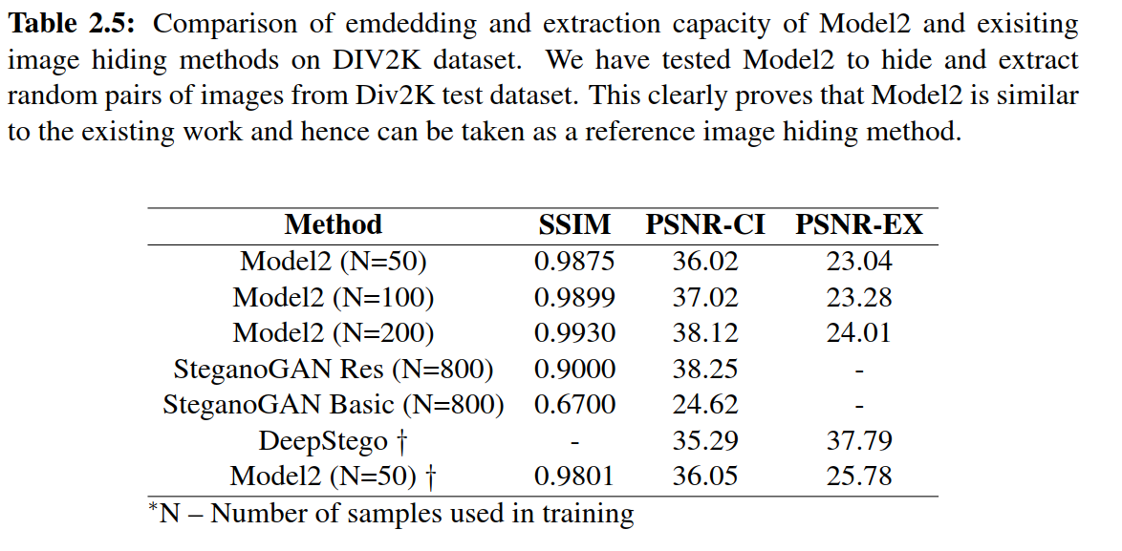
Experiment
To prove that the existing methods can not hide audio in images.

Slide 35
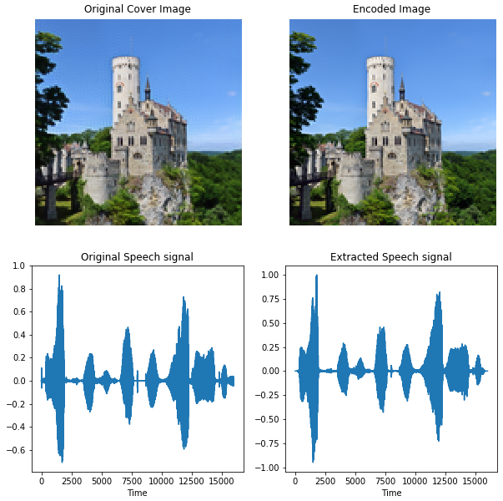

Visual and audio sample
Original File
Extracted File by Model 2
Extracted File by VoI-GAN

Slide 36
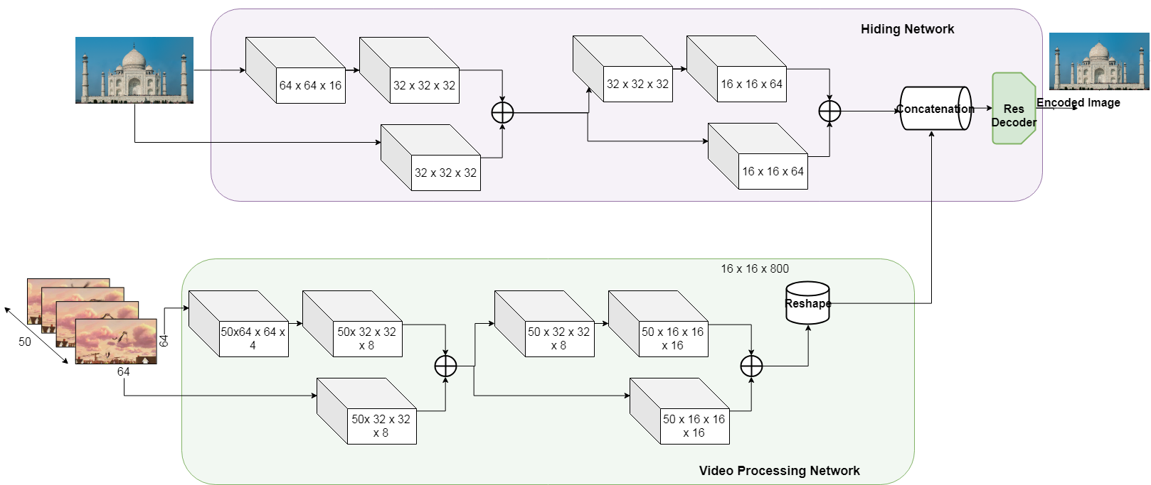
Hiding Video in Image

Slide 37
Introduction
Rohit G, Deepak Mishra, Hiding Video in Images using temporal GANs, Submission to IEEE International Workshop on Information Forensics and Security (WIFS)
This is a completely new variant of data hiding, the novelty of this work also includes the proposal of this new research area.
We propose two working models using deep generative models.
Using Recurrent Neural Networks.
Using 3-D spatio temporal Convolutional networks.
More detailed analysis and refining of these models are the possibilities for the future work.

Slide 38
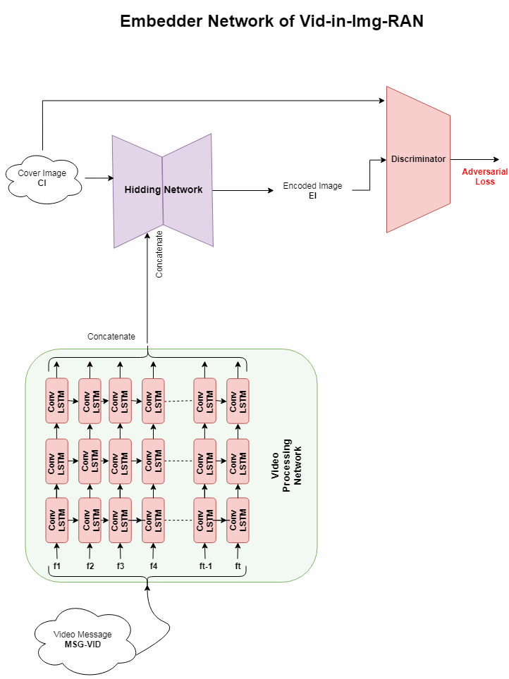
Proposed Method - RNN version (Vid-in-Img-RAN)
The very first attempt to hide video in image.
Video Processing Network (many-to-many RNN) to extract features of video and a shape them into 3D.
Hiding Network (simple autoencoder) takes the cover image produces an encoded image by concatenating the video latent representations.
Video Processing Network is built with stacks of LSTM cells with convolutions (Conv LSTM).
Hiding Network is built with traditional 2D convolution layers.

Slide 39
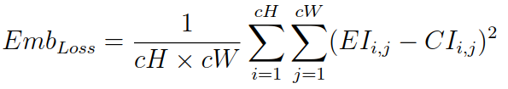


Proposed Method - RNN version (Vid-in-Img-RAN)
)

Slide 40

Proposed Method - RNN version (Vid-in-Img-RAN)
Extraction is the most challenging task.
A convolution layer that acts like temporal feature extractor.
All the spatially channel activations are converted to temporal features.
The main body of extractor is another RNN stack with convolutions.
The output will be a 4D data with 3D temporal frames

Slide 41



Proposed Method - RNN version (Vid-in-Img-RAN)

Slide 42
Drawback
The drawback is the structure of a vanilla LSTM. The first cell has no information except the input, while the last has all the important past info.
Solutions
Using bi-directional LSTM.
Using 3D convolution layer.

Slide 43

Proposed Method - 3D GAN version (Vid-in-Img-3D-GAN)
Slightly refined version with less number of computational operations and a more involved method.
Video Processing Network (3D Conv net) to extract features of video and a shape them into 3D.
Hiding Network (simple autoencoder) takes the cover image produces an encoded image by concatenating the video latent representations.

Slide 44

Proposed Method - 3D GAN version (Vid-in-Img-3D-GAN)
A res layer with convolutions that acts like temporal feature extractor.
All the spatially channel activations are converted to temporal features.
The main body of extractor is stack with 3D convolutions.
The output will be a 4D data with 3D temporal frames.
We introduce a video level and a frame level discriminator.
We also introduce a motion loss to maintain the temporal smoothness in the videos. (Compensation for RNN)

Slide 45


Analysis
First frame vs a later frame
Vid-in-Img-RAN
Vid-in-Img-3D-GAN

Slide 46


Analysis
Histogram analysis to check pixel-level distortions

Slide 47


Visual Results
Vid-in-Img-RAN
Vid-in-Img-3D-GAN

Slide 48
Conclusion
Proposed 5 novel deep generative models that are end-to-end trainable for multimedia data hiding.
Proposed a novel research area of hiding video in images.
All the methods had a similar base structure but due to the modality of multimedia, they had their own unique requirements.
All the models can be used for strategic purposes and can be adopted by ISRO for information security, data hiding and watermarking.
Although the proposed models are for the application of data hiding, they are generic and can be directly adopted into applications like data privacy, 3D mesh model watermarking, data security, cryptography etc.
This work is fully open-sourced for further academic improvements on this research.

Slide 49
Future Work
Improving the proposed video hiding techniques.
Exploring the applications like 3D mesh watermarking, audio watermarking, medical information, biometrics, and data privacy.
All the proposed methods are generic and can be directly adopted into mentioned applications with minimal architectural changes.
Adopting deep learning ways may open new directions and ﬁnd interesting applications in the ﬁeld of Data Hiding.

Slide 50



Thank You
Any doubts ??
(rohit_g@nrsc.gov.in)
(deepak.mishra@iist.ac.in)

